Slide 1

Research Methodology
Research Design
Dr. Arti Arya
Department of Computer Science and Engineering

Slide 2

Research Methodology
Research Design
Dr. Arti Arya
Department of Computer Science and Engineering

Slide 3
Research Methodology
Disclaimer
These slides are prepared from the prescribed text book and other reliable resources from the Internet.
The images are imported from various sites and videos are imported from youtube.com

Slide 4

Research Methodology
Before moving to Research Design: Lets quickly review…..
RESEARCH PROBLEM
Refers to some difficulty which a researcher experiences in the context of either a theoretical or practical situation and wants to obtain a solution for the same.

Slide 5

Research Methodology
Before moving to Research Design: Lets quickly review…..
Must not be an overdone area.
Controversial subject should not become the choice of an average researcher.
Research
Area
Should not be too narrow or too vague.
Subject should be familiar and feasible so that some literature can be looked into.
Before the final selection of a problem is done, a researcher must ask himself the following questions:

Slide 6

Research Methodology
Before moving to Research Design: Lets quickly review…..
Before the final selection of a problem is done, a researcher must ask himself the following questions:
(a) Whether he is well equipped in terms of his background to carry out the research?
(b) Whether the study falls within the budget he can afford?
(c) Whether the necessary cooperation can be obtained from those who must participate in research as subjects?

Slide 7

Research Methodology
Techniques involved in defining a Problem
(i) Statement of the problem in a general way
(ii) Understanding the nature of the problem
(iii) Surveying the available literature:
iv) Developing the ideas through discussions:
(v) Rephrasing the research problem:

Slide 8


Research Methodology
Lets now talk about Research Design
Meaning of Research Design
A research design is the arrangement of conditions for collection and analysis of data in a manner that aims to combine relevance to the research purpose with economy in procedure.
Claire Selltiz and others, Research Methods in Social Sciences, 1962, p. 50
OR
A general plan of how we will answer our research questions.

Slide 9

Research Methodology
Lets now talk about Research Design
Courtesy: https://www.youtube.com/watch?v=SwRIhMstINg&t=18s

Slide 10

Research Methodology
Research Design
The design decisions happen to be with respect to:
What is the study about?
Why is the study being made?
Where will the study be carried out?
What type of data is required?
Where can the required data be found?
What periods of time will the study include? What will be the sample design?
What techniques of data collection will be used? How will the data be analysed?
In what style will the report be prepared?

Slide 11

Research Methodology
Research Design: can be divided into following parts
Observational Design
Sampling Design
Operational Design
Statistical Design

Slide 12


Research Methodology
Need for Research Design
Facilitates the smooth sailing of the various research operations.
Making research as efficient as possible
Yielding maximal information with minimal expenditure of effort, time and money.
The need for a well thought out research design
is at times not realised by many
Courtesy: https://gifer.com/en/3QCY

Slide 13


Research Methodology
When a design is a good design?
If it is flexible, appropriate, efficient, economical and so on
Which minimises bias and maximises the reliability of the data collected and analysed is considered a good design
(i) The means of obtaining information;
(ii) The availability and skills of the researcher and his staff, if any;
(iii) The objective of the problem to be studied;
(iv) The nature of the problem to be studied; and
(v) The availability of time and money for the research work.
RD Considers following factors:

Slide 14


Research Methodology
Research Design: Important Concepts
1
Dependent and independent variables
5
Research hypothesis
2
Extraneous variable
6
Expe and non-experimental hypothesis-testing research
3
Control
7
Experimental and control groups
4
Confounded relationship
8
Treatments

Slide 15
Research Methodology
Research Design: Important Concepts
9
Experiment
10
Experimental unit(s)

Slide 16
Research Methodology
1. Dependent and independent variables
Variable: A concept which can take on different quantitative values.
Eg, concepts like weight, height, income, etc.
Continuous variables – phenomena which can take on quantitatively different values even in decimal points.
Eg, age.
Discontinuous or Discrete variables – If some variables can only be expressed in integer values.
Eg, no. of children.

Slide 17
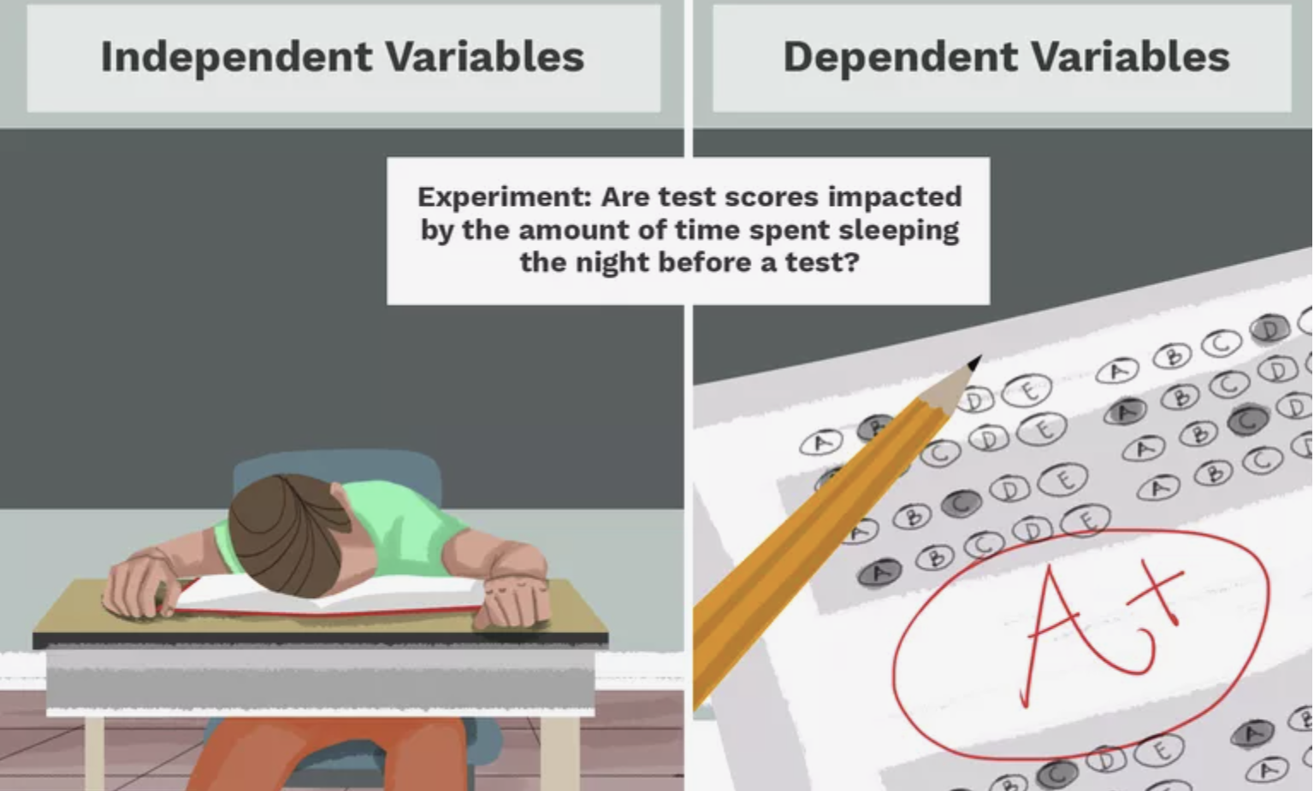
Research Methodology
1. Dependent and independent variables
If one variable depends upon or is a consequence of the other variable, it is termed as dependent variable
The variable that is antecedent to the dependent variable is termed as independent variable.
https://www.thoughtco.com/independent-and-dependent-variable-examples-606828

Slide 18
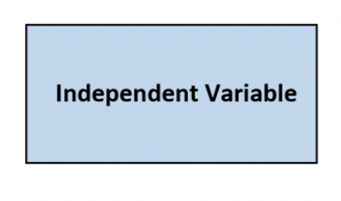
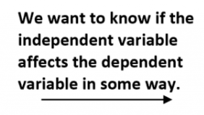
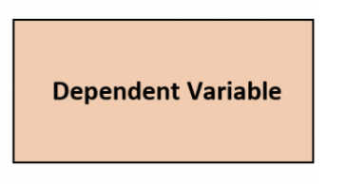
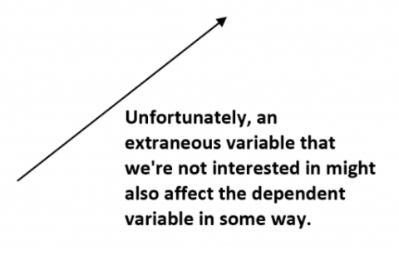
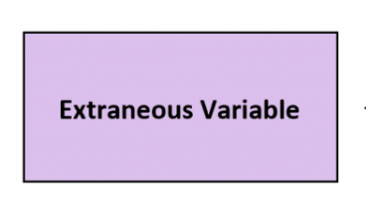


Research Methodology
2. Extraneous Variables
The variables that are not related to the study but may affect the dependent variable are termed as extraneous variables
Whatever effect is noticed on dependent variable as a result of extraneous variable(s) is technically described as ‘experimental error’.

Slide 19
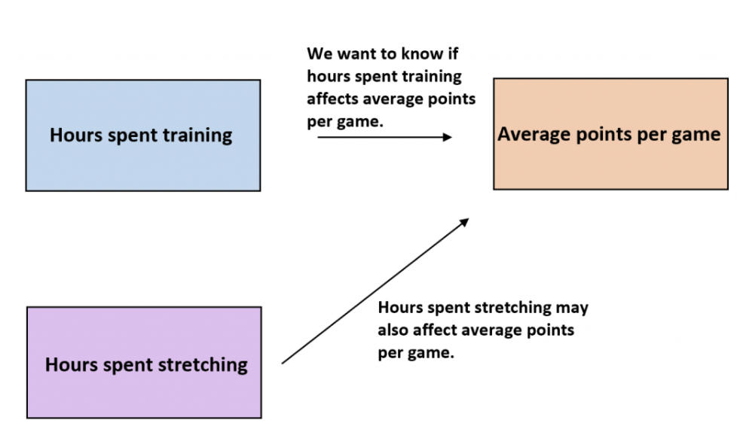

Research Methodology
2. Extraneous Variables

Slide 20


Variables of the environment that could affect the way an individual behaves in an experiment.
Eg, Lighting conditions, Noise, Visual distractions, Temperature
Research Methodology
Types of Extraneous variables
Situational Variables
This refers to ways in which the experimenter may accidently bias the way that individuals behave in an experiment.
Eg Using certain phrasing to hint at the way researchers want individuals to behave.
Experimenter Bias
Demand Characteristics
Participant Variables

Slide 21

Research Methodology
Types of Extraneous variables
Situational Variables
This refers to any clues in the experiment that could give away the true purpose of the research to the individuals. Eg Their surroundings.
Their interpretation of what is happening in the situation.
The researcher’s behavior.
Experimenter Bias
Demand Characteristics
This refers to the natural variance among individuals and the ways in which this could affect the results of the experiment. Eg An individual’s natural intelligence.
An individuals’ mood that day.
Participant Variables

Slide 22

Research Methodology
3. Control
The technical term ‘control’ is used when we design the study minimising the effects of extraneous independent variables.
A control variable (or scientific constant) is an experimental element which is constant and unchanged throughout the course of the investigation.
Control variables could strongly influence experimental results, were they not held constant during the experiment in order to test the relative relationship of the dependent and independent variables
In experimental researches, the term ‘control’ is used to refer to restrain experimental conditions.
.

Slide 23

Research Methodology
4. Cofounded Relationship
Confounding variables (a.k.a. confounders or confounding factors) are a type of extraneous variable that are related to a study’s independent and dependent variables.
A variable must meet two conditions to be a confounder:
It must be correlated with the independent variable. This may be a causal relationship, but it does not have to be.
It must be causally related to the dependent variable.
When extraneous variable influences dependent variable, the relationship between dependent and independent variables is stb confounded by an extraneous variable.
Courtesy: https://www.scribbr.com/methodology/confounding-variables

Slide 24

Research Methodology
4. Confounding Variable
.

Slide 25

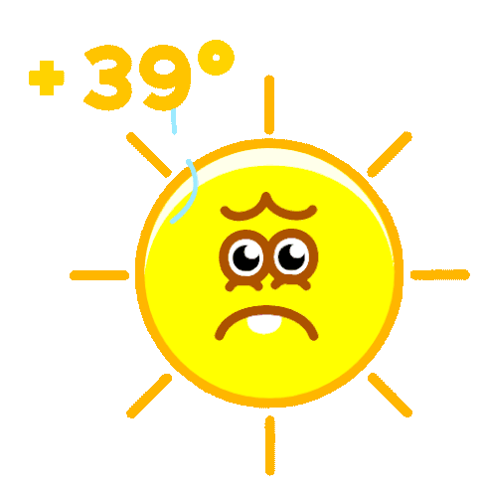


Research Methodology
Example of a cofounding relationship( variable)
Data on sunburns and ice cream consumption.
Its found that higher ice cream consumption is associated with a higher probability of sunburn.
Does that mean ice cream consumption causes sunburn?
Here, the confounding variable is TEMPRATURE: hot temperatures cause people to both eat more ice cream and spend more time outdoors under the sun, resulting in more sunburns.
https://tenor.com/view/calor-cuiab%C3%A1-hot-sun-quente-gif-18290806

Slide 26
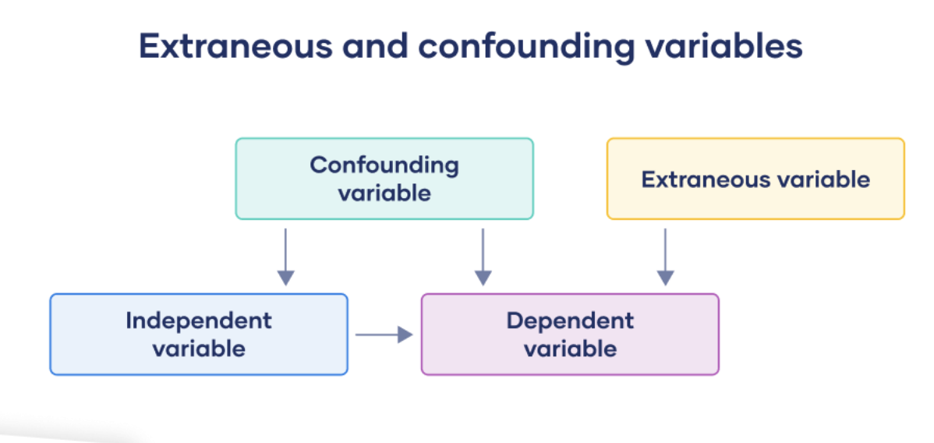

Research Methodology
Confounding relationship( variable) & Extraneous variable
https://tenor.com/view/calor-cuiab%C3%A1-hot-sun-quente-gif-18290806

Slide 27

Research Methodology
Confounding relationship( variable) & Extraneous variable
Example: Experimental study
In a study on mental performance, you test ( hypothesis)
whether wearing a white lab coat (independent variable) improves
scientific reasoning (your dependent variable).
You recruit students from a university to participate in the study.
You manipulate the independent variable by splitting participants into two groups:
Participants in the experimental group are asked to wear a lab coat during the study.
Participants in the control group are asked to wear a casual coat during the study.

Slide 28
Research Methodology
Confounding relationship( variable) & Extraneous variable
All participants are given a scientific knowledge quiz, and their scores are compared between groups.
In your experiment, following extraneous variables can affect the science knowledge scores:
Participant’s major (e.g., STEM or humanities)
Participant’s interest in science
Demographic variables such as gender or educational background
Time of day of testing
Experiment environment or setting
Controlling extraneous variables is an important aspect of experimental design. When you control an extraneous variable, you turn it into a control variable.

Slide 29

Research Methodology
Confounding relationship( variable) vs. Extraneous variable
Having participants who work in scientific professions (in labs) is a confounding variable in your study, because this type of work correlates with wearing a lab coat( independent vari.) and better scientific reasoning( dependent vari.)
People who work in labs would regularly wear lab coats and may have higher scientific knowledge in general. Therefore, it’s unlikely that your manipulation will increase scientific reasoning abilities for these participants.
Variables that only impact on scientific reasoning are extraneous variables. These include participants’ interests in science and undergraduate majors. While interest in science may affect scientific reasoning ability, it’s not necessarily related to wearing a lab coat.

Slide 30
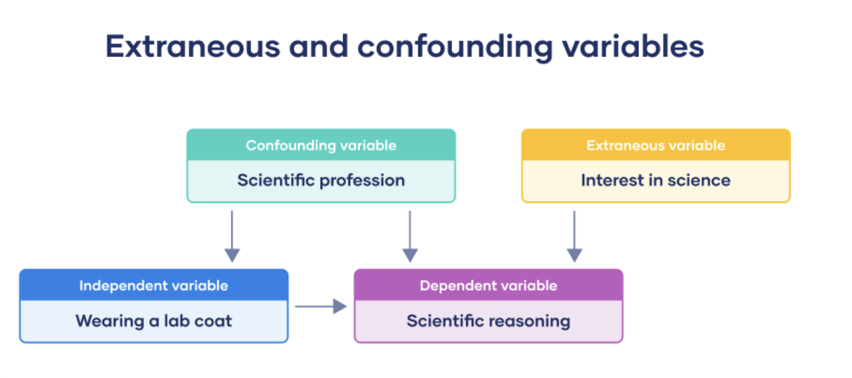

Research Methodology
Confounding relationship( variable) vs. Extraneous variable

Slide 31

Research Methodology
5. Research Hypothesis
When a prediction or a hypothesis relationship is to be tested by scientific methods, it is termed as ‘research hypothesis’.
Is a predictive statement that relates an independent variable to a dependent variable.
Must contain at least, one independent and one dependent variable.
RH: What is the effect of diet and regular soda on blood sugar levels? The type of soda you drink: Independent variable and Your blood sugar levels : dependent variable.
RH: How does phone use before bedtime affect sleep?
The amount of phone use before bed, Number of hours of sleep, Quality of sleep

Slide 32

Research Methodology
6. Experimental and Non-experimental Hypothesis-testing Research
Purpose of Research is to Test Research Hypothesis---→ Hypothesis testing Research
Experimental Hypothesis-testing Research – Independent variable is manipulated
Non-experimental Hypothesis-testing Research – Independent variable NOT manipulated

Slide 33

Research Methodology
Example: Non Experimental Hypothesis testing Research
Suppose a researcher wants to study whether “Intelligence affects reading ability for a group of students”
So he randomly selects 50 students and tests their intelligence and reading ability by calculating the coefficient of correlation between the two sets of scores.
This is an example of non-experimental hypothesis-testing research
( WHY? )
Bcoz, Here the independent variable: Intelligence, is not manipulated.

Slide 34

Research Methodology
Example: Experimental Hypothesis testing Research
Now lets say that the researcher randomly selects 50 students from a group of students who wants to take statistics course and then divides them into two groups by randomly assigning 25 to Group A, the usual studies programme, and 25 to Group B, the special studies programme.
At the end of the course, he gives a test to each group in order to judge the effectiveness of the training programme on the student’s performance-level.
This is an example of experimental hypothesis-testing research
bcoz in this case the independent variable, viz., the type of training programme, is manipulated.

Slide 35

Research Methodology
Research Design

Slide 36
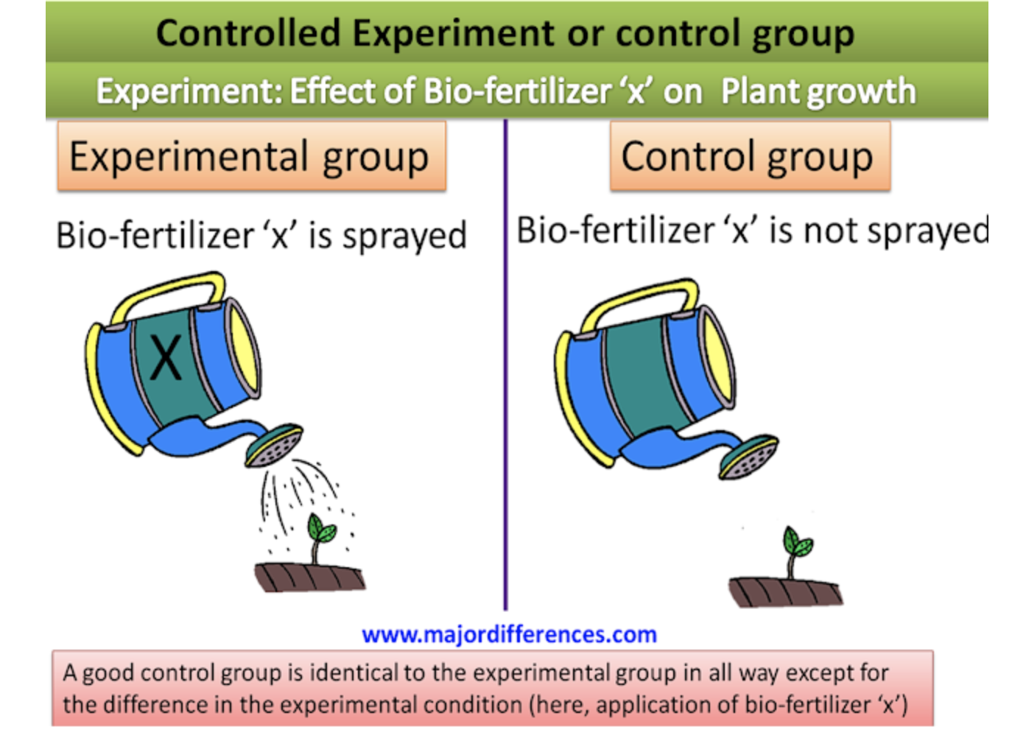

Research Methodology
7. Experimental and Control Groups
In an experimental hypothesis-testing research when a group is exposed to usual conditions, it is termed a ‘control group’,
When the group is exposed to some novel or special condition, it is termed an ‘experimental group’.

Slide 37

Research Methodology
Example:
Now lets say that the researcher randomly selects 50 students from a group of students who wants to take statistics course and then divides them into two groups by randomly assigning 25 to Group A, the usual studies programme, and 25 to Group B, the special studies programme.
At the end of the course, he gives a test to each group in order to judge the effectiveness of the training programme on the student’s performance-level.
This is an example of experimental hypothesis-testing research
bcoz in this case the independent variable, viz., the type of training programme, is manipulated.
Group A : CONTROL Group
Group B: EXPERIMENTAL GROUP

Slide 38

Research Methodology
8. Treatments
The different conditions under which experimental and control groups are put are usually referred to as ‘treatments’.
The two treatments are the usual studies programme and the special studies programme

Slide 39

Research Methodology
9. Experiment
The process of examining the truth of a statistical hypothesis, relating to some research problem, is known as an experiment.
Consider an experiment to examine the usefulness of a certain newly developed drug.
Experiments can be of two types: absolute and comparative
If we want to determine the impact of a fertilizer on the yield of a crop, it is a case of absolute experiment; but if we want to determine the impact of one fertilizer as compared to the impact of some other fertilizer, our experiment then will be termed as a comparative experiment.
Usually undertake comparative experiments when we talk of designs of experiments.

Slide 40

Research Methodology
10. Experimental Units
The pre-determined plots or the blocks, where different treatments are used, are known as experimental units. Such experimental units must be selected (defined) very carefully.

Slide 41
THANK YOU
Dr. Arti Arya
artiarya@pes.edu

